Slide 1
Random Forest Description
Amos
2016.9.9
9.9
1.Explain the details of construction of trees and RF.
2. Add ‘ variable interaction’ part
3. 完善scaling 部分
Note: not ‘imbalanced data’ part
完善prototype部分
增加了missing variables replacement for test set (no labels)
还需要增加interaction 部分
8-18: 需要增加不均衡数据处理

Slide 2
Introduction
This section gives a brief overview of random forests and some comments about the features of the method.

Slide 3
Overview
Each tree gives a classification, and we say the tree "votes" for that class. The forest chooses the classification having the most votes (over all the trees in the forest).

Slide 4
Each tree is grown as follows: 1 . If the number of cases in the training set is N, sample N cases at random ­ but with replacement, from the original data. This sample will be the training set for growing the tree. 2. If there are M input variables, a number m<<M is specified such that at each node, m variables are selected at random out of the M and the best split on these m is used to split the node. The value of m is held constant during the forest growing. 3. Each tree is grown to the largest extent possible. There is no pruning
A new random subset is generated at each node, with the variable and cutpoint that produce the greatest average information gain selected to split the node.

Slide 5
the forest error rate depends on ?
In the original paper on random forests, it was shown that the forest error rate depends on two things: The correlation between any two trees in the forest. Increasing the correlation increases the forest error rate. The strength of each individual tree in the forest. A tree with a low error rate is a strong classifier. Increasing the strength of the individual trees decreases the forest error rate.
Reducing m reduces both the correlation and the strength.

Slide 6
How random forests work?
When the training set for the current tree is drawn by sampling with replacement, about one­ third of the cases are left out of the sample. This oob (out­of­bag) data is used to get a running unbiased estimate of the classification error as trees are added to the forest. It is also used to get estimates of variable importance.
After each tree is built, all of the data are run down the tree, and proximities are computed for each pair of cases. If two cases occupy the same terminal node, their proximity is increased by one. At the end of the run, the proximities are normalized by dividing by the number of trees.
Notes:
Proximities are
used in replacing missing data, locating outliers, and producing illuminating low­dimensional views
of the data.

Slide 7
The out­of­bag (oob) error estimate
In random forests, there is no need for cross­validation or a separate test set to get an unbiased estimate of the test set error. It is estimated internally, during the run, as follows:
Each tree is constructed using a different bootstrap sample from the original data. About one­ third of the cases are left out of the bootstrap sample and not used in the construction of the kth tree.
Put each case left out in the construction of the kth tree down the kth tree to get a classification. In this way, a test set classification is obtained for each case in about one­ third of the trees. At the end of the run, take j to be the class that got most of the votes every time case n was oob. The proportion of times that j is not equal to the true class of n averaged over all cases is the oob error estimate.

Slide 8
Variable importance
In every tree grown in the forest, put down the oob cases and count the number of votes cast for the correct class. Now randomly permute the values of variable m in the oob cases and put these cases down the tree. Subtract the number of votes for the correct class in the variable ­m­ permuted oob data from the number of votes for the correct class in the untouched oob data. The average of this number over all trees in the forest is the raw importance score for variable m.

Slide 9
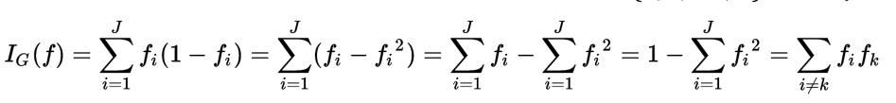
Gini importance
o compute Gini impurity for a set of items with classes, suppose , and let be the fraction of items labeled with class in the set.
Every time a split of a node is made on variable m the gini impurity criterion for the two descendent nodes is less than the parent node. Adding up the gini decreases for each individual variable over all trees in the forest gives a fast variable importance that is often very consistent with the permutation importance measure.

Slide 10
Variable Interactions
What is ‘interactions’?
variables m and k interact if a split on one variable, say m, in a tree makes a split on k either systematically less possible or more possible.[source]
Another way to put this is that the effect of one independent variable may depend on the level of the other independent variable.
Interaction When there are two independent variables, the relationship between Y and X1 may depend on X2: that dependency is called interaction.
Notes:
Correlation? 1 ←---→ 1 （=>多个特征两两互相相关）
酶有无和蛋白质活力 与 生物机体 细胞的活力。。不是相关性 1← 1
More complicated: 多个特征 联合或单独 地对一个或多个特征有这样一个条件关系

Slide 11
[Distance-based]If variable m1 is correlated with variable m2 then a split on m1 will decrease the probability of a nearby split on m2 . The distance between splits on any two variables is compared with their theoretical difference if the variables were independent.

Slide 12
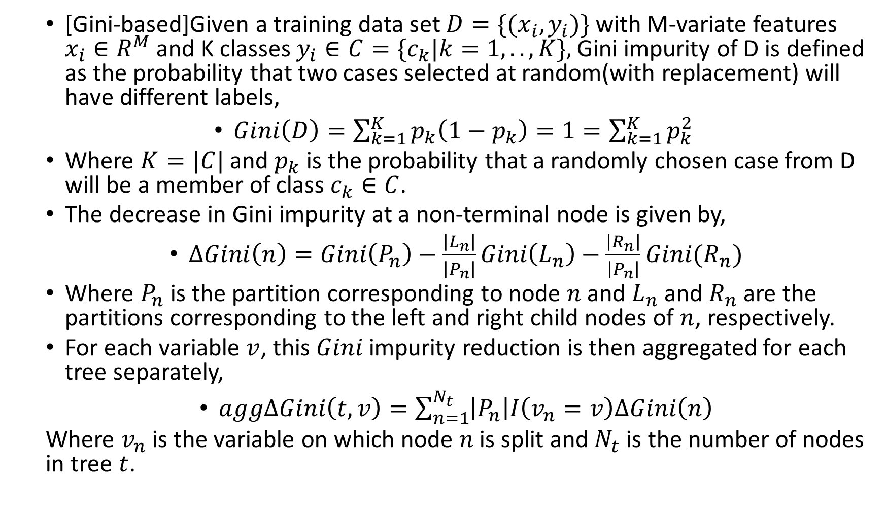
[Gini-based]Given a training data set $D=\{(x_{i},y_{i})\}$with M-variate features $x_{i}∈R^{M}$and K classes $y_{i}∈C=\{c_{k}|k=1, .., K\},$Gini impurity of D is defined as the probability that two cases selected at random(with replacement) will have different labels,
$Gini\left(D\right)=\sum_{k=1}^{K}{p_{k}\left(1−p_{k}\right)=1=\sum_{k=1}^{K}{p_{k}^{2} }}$
Where $K=|C|$and $p_{k}$ is the probability that a randomly chosen case from D will be a member of class $c_{k}∈C$.
The decrease in Gini impurity at a non-terminal node is given by,
$∆Gini\left(n\right)=Gini\left(P_{n}\right)−\frac{\left|L_{n}\right|}{\left|P_{n}\right|}Gini\left(L_{n}\right)−\frac{\left|R_{n}\right|}{\left|P_{n}\right|}Gini(R_{n})$
Where $P_{n}$is the partition corresponding to node $n$and $L_{n}$and $R_{n}$are the partitions corresponding to the left and right child nodes of $n$, respectively.
For each variable $v$, this $Gini$impurity reduction is then aggregated for each tree separately,
$agg∆Gini\left(t,v\right)=\sum_{n=1}^{N_{t}}{\left|P_{n}\right|I\left(v_{n}=v\right)∆Gini\left(n\right)}$
Where $v_{n}$is the variable on which node $n$is split and $N_{t}$is the number of nodes in tree $t$.

Slide 13
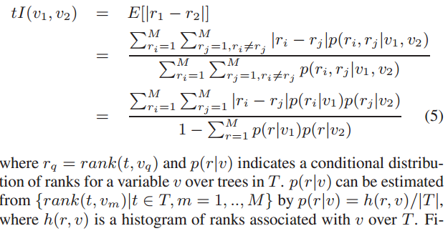
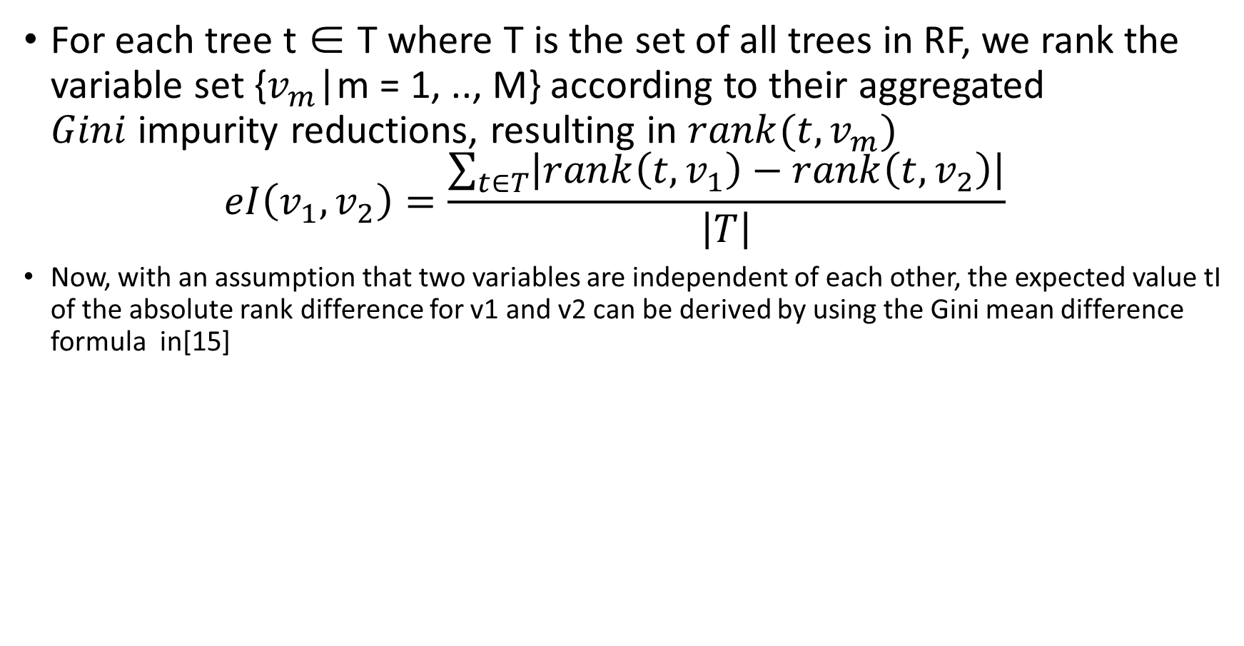
For each tree t ∈ T where T is the set of all trees in RF, we rank the variable set {$v_{m}$|m = 1, .., M} according to their aggregated $Gini$impurity reductions, resulting in $rank(t, v_{m})$ $eI\left(v_{1},v_{2}\right)=\frac{\sum_{t∈T}{\left|rank\left(t,v_{1}\right)−rank\left(t,v_{2}\right)\right|}}{\left|T\right|}$
Now, with an assumption that two variables are independent of each other, the expected value tI of the absolute rank difference for v1 and v2 can be derived by using the Gini mean difference formula in[15]

Slide 14

Note: 上面的公式 翻译为： $v_{1}$，v2 在T中每个t上都有$rank$，每个$rank$都有一个频率(概率)。求$|r_{i}−r_{j}|$的观测值。
分子：对所有的取值进行遍历
分母：抵消分子中的权。
最后一个等号是在理论不相关的情况下可以进行的分解
Notes:
Need modifyed.
See the paper printed.

Slide 15
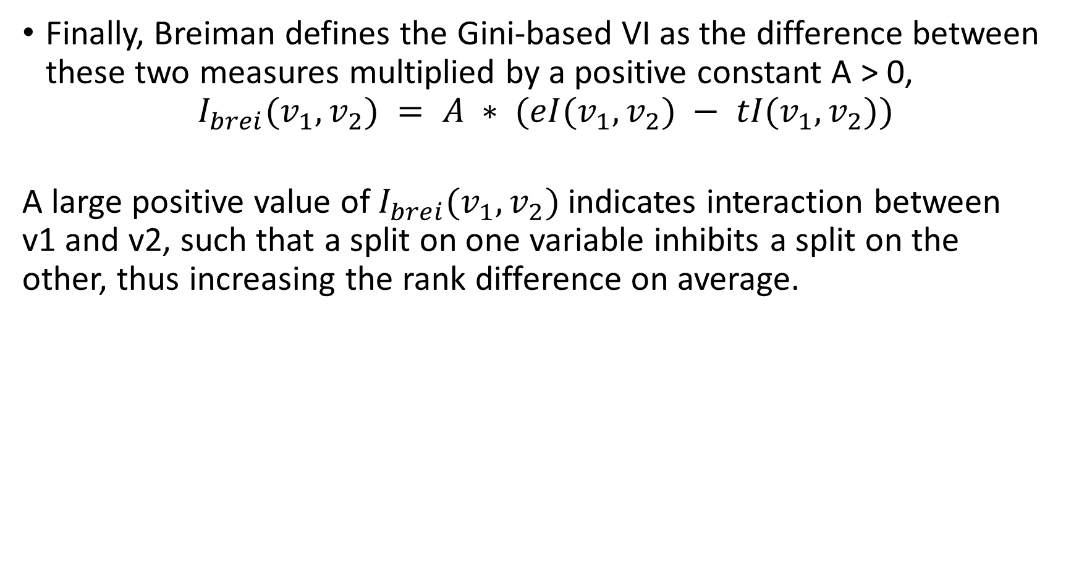
Finally, Breiman defines the Gini-based VI as the difference between these two measures multiplied by a positive constant A > 0,
$$I_{brei}(v_{1}, v_{2}) = A ∗ (eI(v_{1}, v_{2}) − tI(v_{1}, v_{2}))$$ A large positive value of $I_{brei}(v_{1}, v_{2})$indicates interaction between v1 and v2, such that a split on one variable inhibits a split on the other, thus increasing the rank difference on average.
Notes:
检测 1 对 1 有相关关系这种情况(每一个特征都能够使得分类结果变好)

Slide 16
Proximities
The proximities originally formed a NxN matrix. After a tree is grown, put all of the data, both training and oob, down the tree. If cases k and n are in the same terminal node increase their proximity by one. At the end, normalize the proximities by dividing by the number of trees.

Slide 17
Scaling
归一化
用低维特征替换高维特征

Slide 18
Prototypes
Prototypes are a way of getting a picture of how the variables relate to the classification.
第I 类 的prototype（模型）：在I类中它的k领域中有最多的I类样本
（在寻找新的prototype时候，已经在之前prototype领域中的样本不被计数）
Prototype是数据集中的代表性case
Apart from showing the proximity of cases these distance matrices, and their metrically scaled projections, can be used to:
replace missing values,
locate outliers and
investigate how the predictors separate the classes by locating 'prototypes'.
Notes:
Prototypes are a way of getting a picture of how the variables relate to the classification.
Where is the relationship?
The association, or proximity, between cases is the number of times that they occur together in the same terminal node. These counts are normalized by dividing by the number of trees, producing a proximity matrix that can be analysed using a metric scalingmethod. Apart from showing the proximity of cases these distance matrices, and their metrically scaled projections, can be used to:
replace missing values,
locate outliers and
investigate how the predictors separate the classes by locating 'prototypes'.

Slide 19
Missing value replacement for the training set
two ways:
11)not categorical variable(assuming of class j): computing the median of all values of this(the) variable in class j;
12)categorical variable(assuming of class j): computing the most frequency non-missing value in class j;
Fill the value (called fill(s)) to the missing place in class j;
A better way is as follows:(assuming x(mth variable, nth case) is the missing value)
21)for continuous value: first doing a rough and inaccurate filling of the missing value.
then
22)for categorical variable: also replace it by the most frequent non-mission value where frequency is weight by proximity.

Slide 20
Missing value replacement for the test set
测试集
将每一个样本复制n(number of classes)遍
第一个样本，用训练集的class 1 fills 去填充丢失数据。然后用随机森林去预测，对这个样本分类一次（投票一次）
第二个复制样本，用训练集class 2 fills 去填充丢失数据。再分类（投票一次）
….
这个case被分为 被分类最多的那一类

Slide 21
Mislabeled cases
Many of the mislabeled cases can be detected using the outlier measure.

Slide 22
Outliers
Outliers are generally defined as cases that are removed from the main body of the data.
Translate this as: outliers are cases whose proximities to all other cases in the data are generally small.
A useful revision is to define outliers relative to their class.
Thus, an outlier in class j is a case whose proximities to all other class j cases are small.

Slide 23
Balancing prediction error
In some data sets, the prediction error between classes is highly unbalanced. Some classes have a low prediction error, others a high. This occurs usually when one class is much larger than another
Then random forests, trying to minimize overall error rate, will keep the error rate low on the large class while letting the smaller classes have a larger error rate.

